Slide 1
Factory-X
Requirements of Use Cases
Ulrich Löwen

Slide 2
Classification of requirements
MX-Port requirements
  Requirements for all MX-Port configurations
  Classified according the layer of MX-Port: MX Discovery, MX Access and Usage Control, MX Gate, MX Converter, MX Adapter
Clarification requests
  Internal TP2^{*)} requests for specific additional information to understand discussions in TP4^{*)}
  Typically, priority “very high”
  ^{*)} TP2 is the subproject of Factory-X covering all Use Cases; TP4 is the subproject of Factory-X developing the technical base (MX-Port configurations)
Quality requirements
  Requirements setting guardrails for all normative architecture decisions in the future
  Future ADR proposals shall align with these requirements
Specific MX-Port requirements
  Requirements associated to one or more specific layer of the MX-Port concept
Process requirements
  Requirements setting guardrails for processes to be followed

Slide 3
Overview of Factory-X Requirements (I)
Req. No. | Title | Short description
 |  | requirement purpose
1: quality requirement | Operation of Shared Services | To avoid lock-in, mandatory shared services shall not be operated by only one specific operating company
2: clarification request | MX-Port Conformance | Functional, interface, and conformance specification
3: quality requirement | MX-Port Modularity | Provision of individual constituents of MX -ort by different software providers
4: quality requirement | MX-Port Usability | Easy definition of interfaces and implementation of functionality of MX Port so that it can be mastered by SMEs
5: MX Discovery | Access link | How to manage MX Port Discovery Information
6: MX Access & Usage Ctrl | Identity issuing | How to manage MX Port Identity
7: MX Access & Usage Ctrl | Certification authority | How to enable trust and verification
8: clarification request | MX Port – DSP and DCP | Explain relationship between MX-Port and DSP/DCP on conceptual level
9: quality requirement | Cloud architectures | Considering best practices for cloud architectures
10: clarification request | Shared Services | Framework to discuss business impact of ADRs
11: quality requirement | AAS implementation | Asset Administration Shell usage in the use cases
12: MX Access & Usage Ctrl | Authorization | How to give access to data
13: MX Gate | Notification | Sending/publishing notifications to one or multiple recipients
14: MX Discovery | Broadcast search | Search for companies, applications or products with specific characteristics
15: process requirement | Testbed | Testbed (infrastructure) incl. Hackathons for use cases
16: process requirement | AAS Submodel templates | Guardrails for the proper usage of AAS Submodel Templates
17: MX Access & Usage Ctrl | Usage control | Dealing with usage rights for data offerings
18: MX Access & Usage Ctrl | Public data | No access control necessary
19: MX Access & Usage Ctrl | Restricted data | Protective mechanism defined by data provider
20: MX Gate | Querying of AAS Data | Accessing data by means of queries expressed in a decl. query lang.

Slide 4
Overview of Factory-X Requirements (II)
Req. No. | Title | Short description
 |  | requirement purpose
21: Hercules | EDC discovery | Provision of EDC discovery service
22: clarification request | Timeline | Timeline for MX-Port Leo and MX Port Orion
23: Hercules | Compatibility | Compatibility between MX-Port Hercules and Catena-X EDC
24: quality requirement | Interoperability of MX-Port | Interop. betw. different vendors' implement. of MX-Port or MX-Port layer
25: Hercules | Multiple / federated trust | MX-Port Hercules must be able to trust more than one trust provider
26: Hercules | Streaming | MX-Port Video-Streaming compatibility
27: MX Gate | Integrity and authenticity of data | Uniform solution approach required to sign content of an AAS Submodel
28: clarification request | MX Gate “south” interface | How to provide payload to MX Gate
29: MX Converter | Information representations | Integration of AAS with external information representations
30: quality requirement | Communication Security | Communication Security and Trust Management
31: quality requirement | End-2-End Security | End-2-End Security, also for Mediated Communication
32: quality requirement | Security Hardening | Security Hardening of Network Infrastructure and Components
33: MX Gate | Audit-Safe Logging | Audit-Safe Logging and Signed Receipts
34: MX Converter | Sharing Metadata | Transfer technical data with units of measures
35: MX Gate | Data Sharing Transparency | Dashboard for data transactions
36: clarification request | OPC/UA based MX-Port without​ DCP/DSP | A request for “Orion light” aka “Taurus”
37: MX Gate | Async. Request / Reply for inform. about an asset | Starting workflows, that return asynchronous

Slide 5
Requirement #Number: <Title>
<Short Description>
Illustration (optional)
Initial situation (mandatory)
  <informative description – no requirements>
Problem statement (mandatory)
  <normative description – requirements>
Boundary conditions (optional)
  <normative description – requirements >
Notes (optional)
  <informative description – no requirements>
Backup information on additional pages (optional)
Template

Slide 6
MX Access and Usage Control
Overall considerations

Slide 7
Overall business requirements
Justified by Factory X North Star
  Each company shall be able to operate its own system in which it manages its own identities^{*)}
    Scalability: Continue to use existing infrastructures and established procedures, to the extent possible
    Scalability: Secure my investment in the installed base
    Scalability: Be able to access and use the data ecosystem, appropriate (cost, time & quality) to my company structure (size, product, market, …)
    Interoperability: Set and use the standards that are relevant for me
  A solution shall be designed in such a way that the identities^{*)} managed in the systems of the individual companies should not be duplicated
    Scalability: Be able to access and use the data ecosystem, appropriate (cost, time & quality) to my company structure (size, product, market, …)
  The access to a solution shall be as open as possible, a lock-in by a commercial 3rd party legal entity should be avoided
    Interoperability: Be not locked-in by a specific operating company
    Scalability: Have no restriction on access by application providers
  The costs for integration and operation of a solution shall not be higher than the benefit it provides (this is a matter of course)
*) subject of identities can be legal entities, humans or technical systems (for example a machine or a software service)

Slide 8
Overall scenarios on business level
Scenarios on business level
  Scenario 1 “public data”
  Scenario 2 “restricted data” based on protective mechanism defined by data provider
  Scenario 3 “restricted data” based on protective mechanism, on which data provider and data consumer have agreed
    In general, there are different solutions to such solutions, for example “federated identities” approaches or “self sovereign identities” approaches
Underlying justification by Factory X North Star
  Trust & Security: Divide my business partners into different “trust classes” and then treat them accordingly
  Trust & Security: Divide my data into different “confidentiality levels” and then treat them accordingly
  Interoperability: Be able to choose the level of interoperability that is right for me
Link to Factory X North Star
  The scenarios describe requirements for (probably three different) functional manifestations of MX Access & Usage Control

Slide 9
Cross-company data exchange
MX Access & Usage Control – high level description
Scenarios on business level
Scenario 1: Requirement #18
  As data consumer, I want to receive public data from a data provider without being affected by any access control mechanism
  As data provider, I want to provide public data to a data consumer without being affected by any access control mechanism
Scenario 2: Requirement #19
  As data consumer, I want to receive data from a data provider that is made available to me when I identify myself with an identity provided by the data provider
  As data provider, I want to provide data to data consumer provider, when the data consumer identifies himself with an identity provided by myself
Scenario 3: Requirement #6, #7
  As data consumer, I want to receive data from a data provider that is made available to me when I identify myself with an identity managed by myself; to do this, the data provider needs a mechanism to authenticate my identity
  As data provider, I want to provide data to a data consumer, when the data consumer identifies himself with an identity managed by himself if there is a mechanism that I can authenticate the identity

Slide 10
Requirement #1
Operation of Shared Services – To avoid lock-in, mandatory shared services shall not be operated by only one specific operating company
quality requirement

Slide 11
Requirement #1: Operation of Shared Services
To avoid lock-in, mandatory shared services shall not be operated by only one specific operating company
Illustration
Initial situation
  Shared services are designed and prototypically developed by TP4 and can be used by business applications
  Shared services can be provided by a shared service provider in compliance with the requirements of TP 4 and the governance body
  Shared services can be operated by a shared service operator in compliance with the requirements of TP 4 and the governance body
  There can be mandatory shared services (i.e., a business application shall use the shared service) and optional shared services (i.e., a business application can use the shared service)
Problem statement
  To avoid lock-in, mandatory shared services shall not be operated by only one specific operating company
mandatory shared service
optional shared service
operation open to any certified operating company
lock-in by operating company
operation only by one specific operating company

Slide 12
Requirement #2
MX-Port Conformance – Functional, interface, and conformance specification
clarification request
clarification requests are not published externally

Slide 13
Requirement #3
MX-Port Modularity – Provision of individual constituents of FX Port by different software providers
quality requirement

Slide 14
Requirement #3: MX-Port Modularity
Provision of individual constituents of MX-Port by different software providers
Illustration (example)
Initial situation
  Conceptually, MX-Port is modular and consists of various constituents (MX Discovery, MX Access & Usage Control, MX Gate, MX Converter, MX Adapter)
Problem statement
  It shall be possible that the individual constituents can be provided from different software providers
Boundary conditions
  The current modularization should be critically reviewed again
    MX Access & Usage Control should be renamed, because “access control” and “usage control” address different concerns and the term “usage control” has a different meaning in the general community
  If the individual constituents are provided by different software providers, they shall be integrated into an MX-Port as part of a system integration
MX Port
MX Port
MX Discovery
MX Discovery
MX Access & Usage Ctrl.
MX Access & Usage Ctrl.
MX Gate (requester)
MX Gate (requester)
MX Converter
MX Converter
MX Converter
MX Converter
MX Adapter
MX Adapter
MX Adapter
MX Adapter
business / legacy
application
business / legacy
application
business / legacy
application
business / legacy
application
< / >
software provider 1
< / >
software provider 2
< / >
software provider 3
< / >
software provider 4

Slide 15
Requirement #4
MX-Port Usability – Easy definition of interfaces and implementation of functionality of MX-Port so that it can be mastered by SMEs
quality requirement

Slide 16
Requirement #4: MX-Port Usability
Easy definition of interfaces and implementation of functionality of MX-Port so that it can be mastered by SMEs
Initial situation
  A key aspect of a company's technological sovereignty is to master the technologies essential to its own business
Problem statement
  Companies should therefore be enabled to decide for themselves which constituents of an MX-Port they want to provide themselves and where they want to use 3rd party service providers
    This is a fundamental prerequisite for broad acceptance of Factory-X
  Both the definition of the interfaces of the constituents of an MX-Port and the implementation of the functionality on an implementation technology shall be so simple that it can be mastered by SMEs
Boundary conditions
  The definition of the interfaces of the constituents of an MX-Port should be based on an established international standard

Slide 17
Requirement #5
Access Link – How to manage MX-Port Discovery Information
MX Discovery

Slide 18
Requirement #5: Access Link
How to manage MX-Port Discovery Information
Initial situation
  There is an asset provider and an asset user who want to automatically exchange selected or all data about the asset
  In addition, there are other stakeholders who are interested in the asset, e.g., an engineering or service provider commissioned by an asset user and may also modify or extend the data of the asset during the lifecycle or the asset
  Each stakeholder interested in an asset manages selected or all data about the asset under the own responsibility
  The asset provider provides the asset user with computer-processable data about the asset in the form of “asset identification information”
  Based on the “asset identification information”, a stakeholder who is interested in the asset can establish the association between the asset and the data about the asset managed under the own responsibility
  There are already legal contracts negotiated between the stakeholders concerned regarding their interests in the asset (rights and obligations of the stakeholders concerned)
Problem statement
  The following ways of determining the computer-processable data about the asset in the form of “asset identification information” provided by the asset provider shall be supported
    The “asset identification information” is applied by the asset provider to a physical asset in the form of an optoelectronic computer-readable font; a human shall be able to read this font with an appropriate reading device (provided that the physical conditions allow access to this font at all)
    The “asset identification information” is applied by the asset provider to a physical asset in the form of a human-readable font; a human shall be able to manually enter this font into an appropriate input device (provided that the physical conditions allow access to this font at all)
    Based on knowledge, a human can use information from other sources (for example the “asset identification information” from other assets or databases) to determine the required “asset identification information” and to do an appropriate selection of data.
    Based on proper versioning or other labeling means, a software service can find the relevant data
  For possible solutions, it shall be elaborated what a legal entity shall do once to be able to use this solution and what shall be ensured during operation that the solution can be operated
  For possible solutions, technical, regulatory and economic aspects shall be considered
Boundary conditions
  The data about an asset held by a stakeholder under the own responsibility should follow a standard established in the market (e.g., IEC 63278 Asset Administration Shell)
  The computer-processable data about the asset in the form of “asset identification information” should follow a standard established in the market (e.g., IEC 61406-1 Identification Link)
  The access to a solution should be as open as possible, a lock-in by a commercial 3rd party legal entity should be avoided
  The costs for integration and operating of a solution shall not be higher than the benefit it provides (especially regarding solutions already established on the market)
Notes
  A solution is favored in which the one-off costs and the costs during operation are as low as possible

Slide 19
Backup Requirement #5: Access Link
Examples of possible solutions
Federated solution
  Each legal entity operates a local “discovery registry”
  Standardized format of “asset identification information”
    The “asset identification information” can also be included in the information that is passed on by the provider of the asset to the user of the asset, e.g., as part of a Submodel of the AAS
Evaluation [according requirements]
  No central 3rd party required; no additional costs during operation
  Agreement on a standardized format of “asset identification information”
  Register the “asset identification information” in the own “discovery registry” as part of the contract conclusion between stakeholders interested in the asset
Central registry
  Operating a central “discovery registry” where every company must register its own “asset identification information” or the extension of a given asset ID during lifecycle
Evaluation [according requirements]
  Central 3rd party necessary (lock-in to be discussed)
  To be clarified: who operates the central registry and at what cost to the user
  Agreement on a standardized format of “asset identification information”
  Register the access link in the central “discovery registry” as responsibility of asset provider
Boundary condition
  A central “discovery registry” shall be designed that a company can protect any know-know or IP that it considers worthy of protection when registering

Slide 20
Backup Requirement #5: Access Link
Illustration of AAS ID (IEC 63278) and Asset ID (IEC 61406)
  Typically, the case when product is serialized, and instance specific information is created during production
  Whether the machine supplier discloses the installed components to the factory operator depends on the business strategy of the machine supplier
Component Supplier
Machine Supplier
Factory Operator
provides selected information of instance AAS
provided once, no synchronization
two separate AASs with different AAS IDs
Note: other modeling possible
AAS server
AAS server
AAS server
AAS
AAS ID_{t}
managed by
provides selected information of instance AAS
provided once, no synchronization
two separate AASs with different AAS IDs
Note: other modeling possible, e.g., reference from AAS of Machine Supplier to Submodel of AAS of Component Supplier
AAS
AAS ID_{m}
managed by
AAS
AAS IDmm
managed by
asset
product type
asset
machine
instance
composed of
asset
machine
instance
composed of
supplies labeled machine
machine label does not change upon transfer of ownership of the machine
created during production
AAS
AAS ID_{yy}
AAS
AAS ID yyy
asset
xxx
instance
asset
xxx
instance
AAS
AAS ID_{x}
managed by
AAS
AAS ID_{xx}
AAS
AAS IDxxx
asset
product
instance
asset
product
instance
asset
product
instance
supplies labeled product
product label does not change upon transfer of ownership of the product

Slide 21
Requirement #6
Identity Issuing – How to manage MX-Port Identity
MX Access & Usage Control

Slide 22
Requirement #6: Identity Issuing
How to manage MX-Port Identity
Initial situation
  There are companies that want to collaborate with each other and exchange digital data automatically
  For these purposes, the companies request for globally unique machine-readable identities
Problem statement
  Legal entities shall be enabled to obtain globally unique machine-readable identities from an identity issuer
  For possible solutions, it shall be elaborated what a legal entity shall do once to be able to use this solution and what shall be ensured during operation that the solution can be operated
  For possible solutions, technical, regulatory and economic aspects shall be considered
Boundary conditions
  The machine-readable identities should follow a standard established in the market
  The access to a solution should be as open as possible, a lock-in by a commercial 3rd party legal entity should be avoided
  In specific use cases, there will be requested additional services regarding machine-readable identities, e.g., the authentication of identities, but the solution should be designed in such a way that additional services can be retrofitted and can be optionally booked
Notes
  A solution is favored in which the one-off costs and the costs during operation are as low as possible

Slide 23
Backup Requirement #6: Identity Issuing
Examples of possible solutions
Federated solution
  As part of the contract conclusion, the companies involved publish to each other their own identities, for example based on a globally unique company identity
  Standardized format of identities of legal entities
Evaluation [according requirements]
  No central 3rd party required (unless implied by the standard)
  No additional costs during operation (unless implied by the standard)
  Agreement on a standardized format of identities of legal entities
  Not prepared regarding offering additional services regarding identities
Neutral identity issuer
  Determination of a (new or established) identity issuer, where each company obtains its own identity
Evaluation [according requirements]
  Central 3rd party necessary (lock-in to be discussed)
  To be clarified: who operates the identity issuer and at what cost to the user
  Agreement on a standardized format of identity
  Identity issuer can offer additional services regarding identities

Slide 24
Requirement #7
Certification authority – How to enable trust and verification
MX Access & Usage Control

Slide 25
Requirement #7: Certification Authority
How to enable trust and verification
Initial situation
  Each company manages its own identities and wants to use these for cross company data sharing.
  So, each company can manage identities for these different types of subjects, i.e., technical users and human users. User identities can, e.g., also include attributes of legal/organizational entities and installed business applications or devices.
Problem statement
  Data exchange across companies shall be supported for the following types of subjects: technical users or human users (both, in the context of an organization, i.e., linked to a legal entity)
  Software applications that want to exchange data shall know the identities to manage the access to functions and data of the business applications.
  If an identity is provided to a software application, the requested company shall be able to authenticate the identity of the subject.
  Trust between two companies (requester and provider) shall be possible to be established
    either bilaterally: both negotiate trust relationships on their own
    or via a trusted 3rd party, company i.e., this trusted third party acts as trust anchor for the ecosystem and therewith also for all companies, which want to share data among themselves.
Constraints
  A solution should be designed in such a way that the identities of the individual companies shall not be duplicated.
  The user experience from the perspective of the different business roles (data provider, data consumer, software provider) should be considered.
  Authentication means shall not bound to a specific commercial 3rd party legal entity (i.e., a vendor lock-in shall be avoided, instead open standards shall be applied).
  For specific use cases, additional trust and verification services can be provided, but the solution should be designed so that these additional services can be retrofitted and booked optionally.
  There can be multiple 3rd party companies which operate respective trust/authentication services for the ecosystem.
Notes
  A solution is favored in which the one-off costs and the costs during operation are as low as possible.

Slide 26
Requirement #8
clarification request
clarification requests are not published externally

Slide 27
Requirement #9
Cloud architectures – Considering best practices for cloud architectures
quality requirement

Slide 28
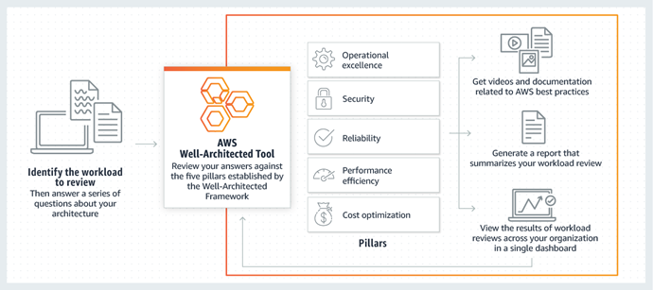
Requirement #9: Cloud architectures
Considering best practices for cloud architectures
Illustration (example)
Initial situation
  There are already many cloud-based solutions being in practical use in the manufacturing industry
  These solution providers have come a long way to gain customers' trust in their solutions
  The providers have made these findings available to the public in best practices
Problem statement
  TP4 shall consider best practices for cloud architectures, especially relevant, but not limited to cloud-to-cloud data exchange in terms of concept and technical implementation
  TP4 shall not prescribe solution architectures for business applications
Notes
  For an example of best practices see https://aws.amazon.com/blogs/aws/aws-well-architected-framework-updated-white-papers-tools-and-best-practices/

Slide 29
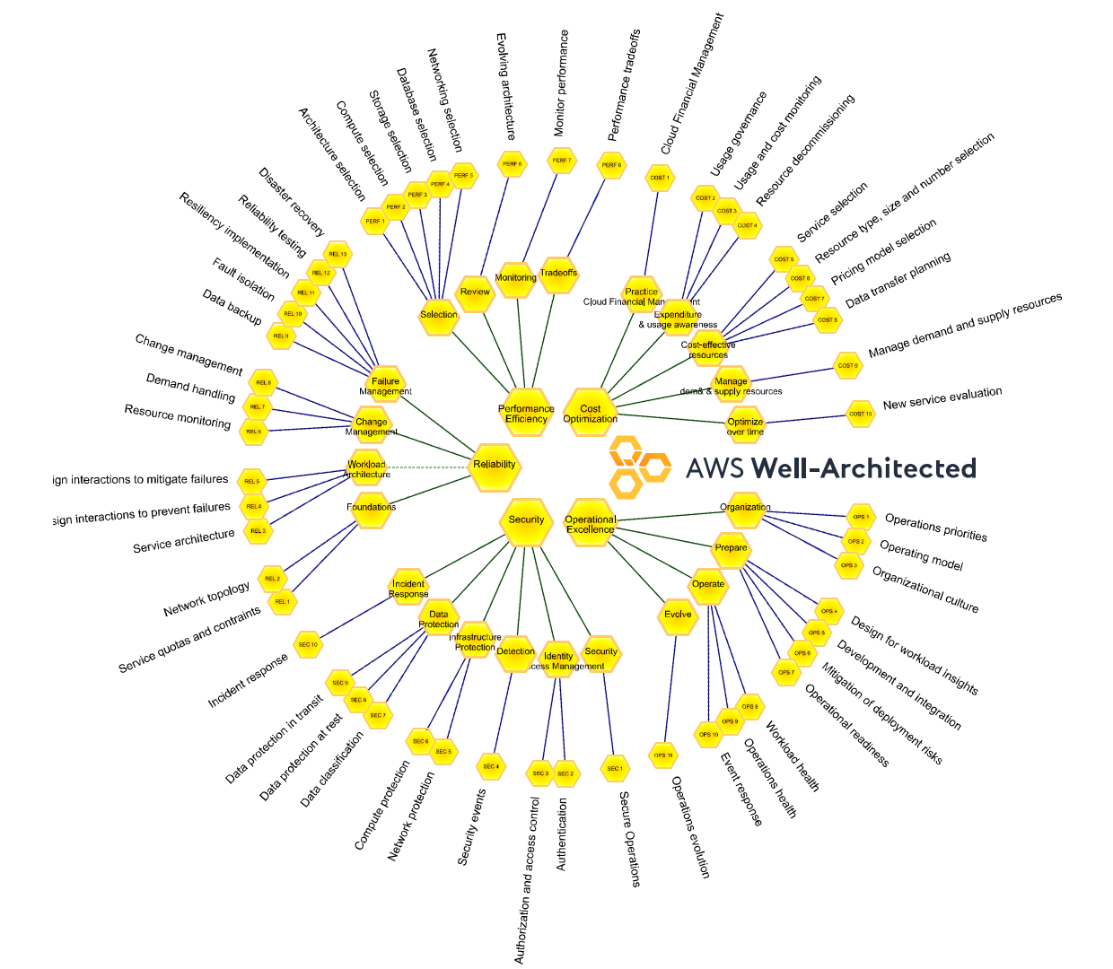
Backup Requirement #9
Breakdown of
  Operational excellence
  Security
  Reliability
  Performance efficiency
  Cost optimization
Source: https://wa.aws.amazon.com/wellarchitected/2020-07-02T19-33-23/wat.map.en.html

Slide 30
Requirement #10
Shared Services – Framework to discuss business impact of ADRs
clarification request
clarification requests are not published externally

Slide 31
Requirement #11
AAS implementation – Asset Administration Shell usage in the use cases
quality requirement

Slide 32
Requirement #11 AAS implementation
Asset Administration Shell usage in the use cases
Initial situation
  Many companies provide information to be shared
  An important semantic model for information in the use cases are Submodels of the Asset Administration Shell (AAS)
Problem statement
  The concepts for modelling assets using the AAS (according to IEC 63278 series) shall not be restricted (MX Converter)
  The access from AAS user applications (according to IEC 63278) to AASs and Submodels shall not be restricted (MX Gate to MX Gate communication)
  The concepts for describing access and usage policies for AASs, Submodels and SubmodelElements (according to IEC63278-3) shall not be restricted
  The AAS shall be expanded to include standardized discovery of AASs across companies (MX Discovery)
  The AAS shall be expanded to enable standardized identification (see Requirement #6), authentication (see Requirement #7), authorization (see Requirement #12), and usage control (see Requirement #17) (MX Access and Usage Control).
Boundary conditions
  Other semantic models like OPC UA companion specifications can exist in parallel
  Other information exchange can exist in parallel

Slide 33
Backup Requirement #11
Standardized conceptual object model (Illustration only)
AAS
AAS ID_{m1}
cross company synchronization
AAS
AAS ID_{mm}
authoring tool A
composed of
asset
ID_{m}
asset
ID_{m}
composed of
AAS
AAS ID_{y1}
AAS
AAS ID_{x1}
AAS
AAS ID_{xx}
AAS
AAS ID_{yy}
asset
ID_{y}
asset
ID_{x}
same asset, but different AASs
asset
ID_{x}
asset
ID_{y}
different AAS of the same asset governed by the same AAS responsible
company internal synchronization
AAS
AAS ID_{m2}
authoring tool B
composed of
asset
ID_{m}
AAS
AAS ID_{y2}
AAS
AAS ID_{x2}
asset
ID_{y}
asset
ID_{x}
same asset, but different AASs
AAS governed by company 1
AAS governed by company 2

Slide 34
Requirement #12
Authorization – How to give access to data
MX Access & Usage Control

Slide 35
Requirement #12: Authorization
How to give access to data
Initial situation
  Each company shares asset or production centric data with other companies. Data sharing is often multilateral between 3 or more companies which have a common interest to share data (e.g., asset supplier, asset operator and one or more service provider, service can be engineering, lifecycle topics including recycling, authorities like TÜV, customs ….).
  Information shared or transferred by business applications shall be accessible for authorized subjects only. A subject always belongs to a company (legal entity). It can be a natural person, a group of persons or technical system for automated workflows which can reduce the workload of persons.
  Access to data offerings can be unlimited or restricted or in addition even subject to usage rights as typically defined in product sheets and T&Cs of the involved companies since pure data can’t be legally owned. (see also Requirement #17 for usage rights)
  Access to data is regulated in various EU data acts, export control and the General Data Protection Regulation (German DGVO), which need to be considered by the owner of a data offering.
Problem statement
  Each company shall have the sovereignty for its data offering and shall be able to control which subjects of its own and other companies can access and use it.
  Based on subjects, the companies shall be able to configure access rights to “their” data which are part of their defined offering.
  The models of access rights or role-based access shall be in the responsibility of the data offering companies, the models may be different for each company or business application.
  It shall be possible to restrict data sharing to a particular time period.
Boundary conditions
  The role-based access is multidimensional. A subject can belong to more than one category of roles (human/machine; role; department, entity, country, etc.)
  The solution shall be designed in such a way that the access policies to the data can be set up by the company owning the offering of the data.
  The solution shall allow a simple rule-based management of access rights based on a common model for the criticality of data to be protected (public, restricted, confidential, strictly confidential). The owner of the offering is responsible for a correct labeling or rule set which allow to protect his data. The solution shall enforce these labels or rules.
  The solution shall be compatible with the legacy applications, at best allowing the legacy applications to use the solution to check access rights and then add the access for subjects of other companies to the legacy system.
  It is assumed that a misuse of an authorized access or usage within a business application can be monitored but not necessarily prevented by the solution. (See also Requirement #17 for details on usage control)

Slide 36
Requirement #13
Notification – Sending/publishing notifications to one or multiple recipients
MX Gate

Slide 37
Requirement #13: Notification
Sending/publishing notifications to one or multiple recipients
Initial Situation
  Polling from the data consumer to the data provider (only synchronous communication available)
  Many manual mechanism and tedious processes – if any – between two companies exist
    Example: Distributing Product Change Notifications
Problem Statement
  Notification Provider shall be able to send/publish a notification for one or multiple Notification Consumer(s)
  Notification Consumer shall be able to send a receipt to the Notification Provider acknowledging reception whenever the notification requires an acknowledgement. This receipt should arrive in reasonable time
  Case 1:
    Notification Consumer shall be able to subscribe to a set of notifications from a Notification Provider
    Notification Consumer and Notification Provider shall be able to unsubscribe from such a notification
  Case 2:
    Notification Provider and Notification Consumer know each other a-priori and shall be able to send and receive notifications.
  Verification of Notification Provider, Notification Consumer and notification shall be possible (see Requirement #7)
  No other than the intended Notification Consumer of any notification shall be able to know the existence or the content of that notification
Boundary Conditions
  A Notification Consumer can basically only be found if the Notification Consumer has agreed to be found
  A lock-in by commercial 3rd party legal entity should be avoided
Notes
  No additional requirements on usage control (see Requirement #17)

Slide 38
Requirement #14
Broadcast search – Search for companies, applications or products with specific characteristics
MX Discovery

Slide 39
Requirement #14: Broadcast search
Search for companies, applications or products with specific characteristics
Initial situation
  A data/service requester needs to find a suitable data/service responder based on specific information/functionality to provide (e.g., properties of an AAS Submodel)
  Examples:
    Finding a supplier of a product with specific properties
    Finding a manufacturing service provider providing specific manufacturing capabilities
    Finding a business application operator operating a business application with specific functionalities
Problem statement
  A data/service requester shall be able to address a request to all data/service responder, which have implemented the “broadcast functional solution” in the MX Discovery Layer of their MX-Port
  Therefore, the MX Discovery layer from the requester shall be able to find all MX Discovery layers from responder and check whether they have the “Broadcast functional solution” implemented
  Additionally, the MX Discovery layer shall be identifiable to confirm its capability to provide the required information or functionality.
    E.g.: The request shall indicate a set [1..m] of properties of AAS Submodels with given property values or property ranges
  As soon as a MX Discovery request found one or more MX Discovery responders, the information/functionality exchange can start
    E.g.: All data/service responder which have the “broadcast functional solution” implemented in their MX Discovery layer shall provide a response if the data/service responder matches the abovementioned request
Boundary conditions
  A data/service responder can basically only be found if the data/service responder has agreed to be found
  A lock-in by commercial 3rd party legal entity should be avoided
  The provider of the information/functionality should be able to verify the legal identity of the requester (Requirement #7)
  The provider of the information/functionality should be able to check the authorization of the requester (Requirement #12)
  It can be assumed the requested information/functionality is described by an AAS; the asset can be for example a product type, a capability or a software application

Slide 40
Requirement #15
Testbed – Testbed (infrastructure) inclusive Hackathons for use cases
process requirement

Slide 41

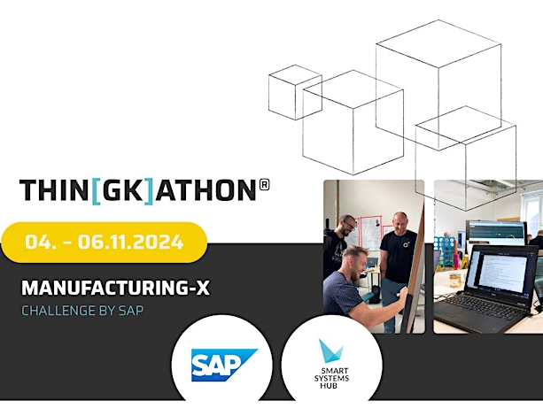
Requirement #15: Testbed
Testbed (infrastructure) inclusive Hackathons for use cases
Illustration (example)
Initial situation
  Use cases want to validate first “walking skeletons” of their business applications, but have no infrastructure to test or deploy them
  Use cases have no idea / information, …
    which shared services are already existing and
    how to use them (lack of hands-on experience with shared service).
Problem statement
  A test infrastructure with hosted shared services (MX-Port elements) shall be provided for validating Use Case “walking skeletons”
  Opportunities to get hands-on experience with relevant technologies (e.g., MX-Port elements such as EDC, AAS server, …) should be created, e.g., by means of hackathons
Notes
  Blueprint: Thin[gk]athon Manufacturing-X Tickets, Mon, Nov 4, 2024 at 9:00 AM | Eventbrite
testbed
hackathon

Slide 42
Requirement #16
AAS Submodel templates – Guardrails for the proper usage of AAS Submodel Templates
process requirement

Slide 43
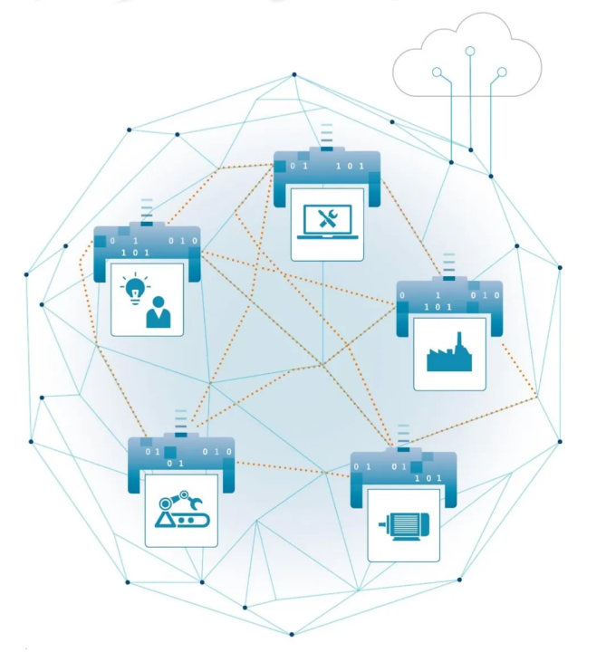
Requirement #16: AAS Submodel Templates
Guardrails for the proper usage of AAS Submodel Templates
Illustration (example)
Initial situation
  Several use cases want to use AAS to model asset data in a standardized form for interoperable data exchange
  Use case actors have different levels of knowledge regarding the proper use of AAS Submodels and Submodel templates
Problem statement
  A governance body shall define and maintain guidelines how to
    develop, publish and maintain Submodel templates – it shall be addressed that the existing Submodel templates are kept consistent with each other
    use Submodels and Submodel templates
  A governance body should define and maintain guidelines how to model complex assets (e.g., machines)
Notes
  IDTA offers consultation hours regarding AAS, especially for the development of Submodel templates by TP2
  The DAVID project, led by IDTA, coordinates the proper usage of AAS within Manufacturing-X and ensures their standardization→ BMWK - Projekt „DAVID“

Slide 44
Requirement #17
Usage control – Dealing with usage rights for data offerings
MX Access & Usage Control

Slide 45
Requirement #17: Usage Control
Dealing with usage rights for data offerings
Initial situation
  Dataspaces in general assume that there are data providers and data consumers, where the data provider has full control over its data offering which he can control via the access rights to ensure that the data offering is accessible for authorized subjects only (see Requirement #12).
  But a data provider want to limit the usage rights of this data offering, which is often technically not possible without big effort once the access rights are granted for another subject. (e.g., for manuals which are not allowed to be copied or redistributed to/for other legal entities)
  Usage rights are therefore typically defined in product sheets and T&Cs of the involved companies since pure data can’t be legally owned.
Problem statement
  Each company shall have the sovereignty for its data offering and shall be able to to monitor (legally approve) how subjects are using the data offering.
  Based on subjects, the companies shall be able to define usage rights to “their” data which are part of their defined offering.
  The models for (role based) usage rights shall be in the responsibility of the data offering companies, the models can be different for each company or business application.
  The usage rights are multidimensional. The subject shall be able to consider more than one category of rights (mass operation; storage; sharing, etc.).
Boundary conditions
  The role-based usage right is multidimensional. A subject can belong to more than one category of roles (human/machine; entity, country, etc..).
  The enforcement of usage rights shall not lead to inappropriate complexity or poor usability of authorization in general. It is assumed that a misuse of an authorized usage can’t necessarily be prevented by the solution (e.g., unauthorized usage, copying or forwarding of data to subjects with no access or usage rights). The solution shall therefore focus on monitoring and reporting (and a high risk to be sued) if prevention is technically impossible.
  The solution shall be designed in such a way that the usage policies for the data can be set up by the company owning the offering of the data.
  The solution shall allow a simple rule-based management of usage rights based on a common model for the criticality of data to be protected (public, restricted, confidential, strictly confidential) and predefined usage categories (e.g. unlimited machine usage and data forwarding, limited machine usage and/or data storage, read only). The owner of the offering is responsible for a correct labeling or rule set which allows to protect the usage of his data offering. The solution shall monitor or report these labels or rules.
  The solution should be a generic reuse service which is integrated or linked to the access right service. The owner of the business application may need to add a kind of “soft sensors” which help the solution to monitor misuse of data offerings.

Slide 46
Requirement #18
Public data – No access control necessary
MX Access & Usage Control

Slide 47
Requirement #18: Public data
No access control necessary
Initial situation
  Many use cases exchange public data between different legal entities
  Sometimes the legislator requires that certain data be made available free of charge (for example, security patches); there is no additional benefit for the data provider by making this data available, so the data provider will meet these requirements with minimal effort
  Data provider and data consumer have agreed on a semantic model of the data to be exchanged (“MX Converter compliant”) and the access mechanisms (“MX Gate compliant”)
Problem statement
  As a human or software application of a data consumer as legal entity, I shall be able to receive public data from a software application of a data provider without being affected by any access control mechanism
  As a software application of a data provider as legal entity, I shall be able to provide public data to a human or software application of a data consumer without being affected by any access control mechanism
  As a data provider and data consumer, I shall be able to not be forced to register at any 3rd party entity for data exchange
Boundary conditions
  Public data can also optionally be linked to usage policies, see Requirement #17
Notes
  A solution is necessary in which the one-off costs and the costs during operation are as low as possible

Slide 48
Requirement #19
Restricted data – Protective mechanism defined by data provider
MX Access & Usage Control

Slide 49
Requirement #19: Restricted data
Protective mechanism defined by data provider
Initial situation
  There are existing infrastructures where restricted data is already exchanged between legal entities
  The data provider provides a mechanism for identification and authentication, and the data consumer uses this mechanism
Problem statement
  As a human or a software application of a data consumer as legal entity, I shall be able to receive data from a software application of a data provider that is made available to me when I identify myself with an identity provided by the data provider
  As a software application of a data provider, I shall be able to provide data to a human or software application of a data consumer, when the human or software application of the data consumer identifies himself with an identity provided by my legal entity
  As a data provider and data consumer, I shall be able not to be forced to register at any 3rd party entity for data exchange
Boundary conditions
  With this approach, a data consumer shall use a specific identification and authentication mechanism for each data provider; as the number of data providers increases, this will no longer be manageable in the future
  Restricted data can also optionally be linked to usage policies, see Requirement #17
Notes
  A solution is necessary in which the one-off costs and the costs during operation are as low as possible

Slide 50
Requirement #20
Querying of AAS Data – Accessing data by means of queries expressed in a decl. query lang.
MX Gate

Slide 51
Requirement #20 – Querying of AAS Data
Accessing data by means of queries expressed in a decl. query lang.
Initial situation
  The current standard way for retrieving AAS data is via the REST API of the AAS
  Therefore, navigation in AAS Submodel structures requires implementation of a programmatic access layer
  The AAS API endpoint is already known
  The programmatic access to more complex Submodels (like Automation Engineering) via REST implies large programming effort and results in hard-coded access logic on client side, which will be hard to maintain over time
    Over-fetching: In many cases, more data than required is fetched and then programmatically filtered, resulting in increased network-traffic
      Example: in case of accessing object dependencies, a whole Submodel needs to be downloaded and then searched through on the client side in a proprietary access logic layer that is hard to maintain and specific to an application
    Under-fetching: REST requests are made specifically; these are processed and lead to corresponding further requests. This means that several hundred requests must be made, which decreases performance
Problem Statement
  It shall be possible to access AAS data by means of queries expressed in a declarative (i.e. not programmatic) query language
Boundary conditions
  Ideally, querying approaches that build on established standards should be utilized for which there is stable and matured tooling available
    Query languages that are already established on the web can simplify access and solve the over- and under-fetching problem

Slide 52
Requirement #21
EDC discovery – Provision of EDC discovery service
Hercules
requirements specific for a MX-Port configuration are consolidated outside TP2

Slide 53
Requirement #22
Timeline – Timeline for MX-Port Leo and MX-Port Orion
clarification request
clarification requests are not published externally

Slide 54
Requirement #23
Compatibility – Compatibility between MX-Port Hercules and Catena-X EDC
Hercules
requirements specific for a MX-Port configuration are consolidated outside TP2

Slide 55
Requirement #24
Interoperability of MX-Port –
Interop. betw. different vendors' implement. of MX-Port or MX-Port layer
quality requirements

Slide 56
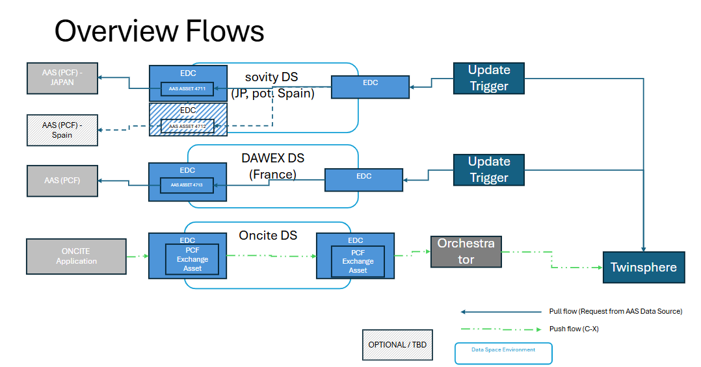
Requirement #24 – Interoperability of MX-Port
Interop. betw. different vendors' implement. of MX-Port or MX-Port layer
Illustration
  Example: IMX Demonstrator Connectivity at HM25
  Implemented by supplier & customer EDC from the same vendor, due to inability to interconnect, which is a consequence of a lack in the Catena-X specification/certification
Initial situation
  Two product implementations of Catena-X EDC are not interoperable (lessons learned from the IMX Demonstrator Connectivity at HM25)
    Incompatibility because of different C-X use case implementations
    Incompatibility because of rejecting not-parseable payload
Problem statement
  Interoperability between different vendors' implementation of the particular MX-Port or MX-Port layer shall be mandatory and shall be checked
  Clear specification of the interoperability of an MX-Port implementation shall be provided and shall be part of the tests and certification

Slide 57
Requirement #25
Multiple / federated trust – MX-Port Hercules must be able to trust more than one trust provider
Hercules
requirements specific for a MX-Port configuration are consolidated outside TP2

Slide 58
Requirement #26
Streaming – MX-Port Video-Streaming compatibility
Hercules
requirements specific for a MX-Port configuration are consolidated outside TP2

Slide 59
Requirement #27
Integrity and authenticity of data – Uniform solution approach required to sign content of an AAS Submodel
MX Gate

Slide 60
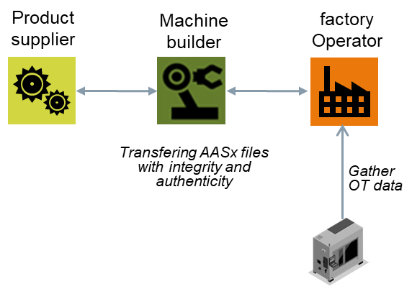
Requirement #27 – Integrity and authenticity of data
Uniform solution approach required to sign content of an AAS Submodel
Integrity and authenticity of AAS(x) data
Initial situation
  The integrity and authenticity of AASx files and Submodels exchanged between companies needs to be ensured.
    Integrity: any modification of the AASx file or submodel can be detected, its integrity verified by the receiving application.
    Authenticity: the creator of the file or submodel can be verified by the receiving application.
Problem statement
  It shall be possible to transfer the AASx file or Submodel several times and its integrity and authenticity can still be verified.
  As an information provider I shall be able to make sure that the data I provide is not manipulated or changed on the way to the recipient.

Slide 61
Requirement #28
MX Gate “south” interface – How to provide payload to MX Gate
clarification request
clarification requests are not published externally

Slide 62
Requirement #29
Information representations – Integration of AAS with external information representations
MX Converter

Slide 63
Requirement #29 – Information Representations
Integration of AAS with external information representations
Initial situation
  The MX-Port configurations Leo and Hercules (and also Factory-X as a project) suggest to utilize an AAS-based representation of information about assets exchanged between business applications
    For a harmonization of data exchange agreed AAS SMTs are used (for example those standardized by IDTA or any other organization)
  But there are use-case specific community standards available for information representation and data exchange that are more established than AAS SMTs (for example STEP AP242 for kinematics)
  In data integration scenarios the combined use of multiple AAS SMTs should provide an integrative view on all relevant information objects within the AAS framework
  Not for all relevant data domains there is an AAS SMT available in sufficient maturity, quality and/or coverage. Therefore, data representation and exchange purely based on AAS with predefined SMTs is not easily possible
Problem statement
  The MX port configurations building on AAS shall enable the combined use of AAS-based information models and established community standards for information representation and data exchange
Boundary conditions
  When embedding community standards in AAS (“gray box” approach), sufficient information should be (re-)modeled within the AAS framework for integrating with related AAS SMTs by means of cross-references within the AAS meta model
  It should not be required to look up such cross-references in AAS-external information objects (for example ithin a STEP file)
Notes
  Typical forms of embedding external information are distinguished in “white box”, “gray box” or “black box” approaches

Slide 64
Requirement #30
Communication Security – Communication Security and Trust Management
quality requirement

Slide 65
Requirement #30: Communication Security
Communication Security and Trust Management
Initial situation
  Two companies want to share data for processing in corresponding business applications
  Shared data is transmitted between the companies via publicly accessible internet communication lines
Problem statement
  Data should be protected against unallowed read-out and non-intended / intended manipulation (i.e., confidentiality and authenticity of data should be ensured) during transmission
  A suitable security protocol for data transport should be activated when data is shared cross-company
  For this purpose, the standard internet protocol Transport Layer Security (TLS) should be used. Correspondingly, TLS certificate generation and management must be specified such that companies sharing data can have trust into the used certificates
Notes
  Developers of communication components are addressed here
  This is more a requirement for the basis architecture than a requirement from the use cases

Slide 66
Requirement #31
End-2-End Security – End-2-End Security, also for Mediated Communication
quality requirement

Slide 67
Requirement #31: End-2-End Security
End-2-End Security, also for Mediated Communication
Initial situation
  Two companies want to share data for processing in corresponding business applications
  Shared data is transmitted between the companies via publicly accessible internet communication lines
  Companies sharing data want to be sure that data is protected and do not want to delegate the protection to the underlying technical communication security measures
Problem statement
  A data provider shall be sure that the confidentiality and authenticity of the data is ensured from the source business / legacy application to its intended destination business / legacy application
Notes
  Technical measures, e.g., by using standard security protocols for data transport, protect the data against unallowed read-out and non-intended / intended manipulation during transmission, but only during one hop
  If data is not protected from the source to the destination, the data consumer cannot be sure that the received data is the same as the sent data. The data provider also can deny having sent this data

Slide 68
Requirement #32
Security Hardening – Security Hardening of Network Infrastructure and Components
quality requirement

Slide 69
Requirement #32: Security Hardening
Security Hardening of Network Infrastructure and Components
Initial situation
  The network infrastructure and components which are intended to be used by companies sharing data are exposed to the internet not only for legitimate these companies
  The network infrastructure and components can be easily attacked by malicious attackers
  Attackers can compromise these components due to security weaknesses or disturb them by DoS or DDoS attacks such that they are not available anymore for data sharing
Problem statement
  Suitable hardening measures should be implemented to make the network infrastructure and components robust against the described attacks
Notes
  Developers and users of network infrastructure and shared services are addressed here
  This is more a requirement for the basis architecture than a requirement from the use cases

Slide 70
Requirement #33
Audit-Safe Logging – Audit-Safe Logging and Signed Receipts
MX Gate

Slide 71
Requirement #33: Audit-Safe Logging
Audit-Safe Logging and Signed Receipts
Initial situation
  Example: A machine builder as data consumer has the obligation to analyze data for a factory operator
    Monitoring data is sent from the factory operator to the machine builder without audit-safe logging, such that
      The factory operator can deny having sent the data to the machine builder or can claim having sent data
      The machine builder can claim having received any or different monitoring data from the factory operator
  The lack of audit-safe logging makes it difficult to prevent such conflicts and comply with audit requirements
Problem statement
  To prevent repudiation issues, a process for audit-safe logging shall be defined which is also compliant to legal aspects
  Audit-safe logging shall be provided by MX-Port implementations
  For data sharing activities signed receipts shall be issued for data consumer and provider
Boundary conditions
  The audit-safe log shall be complete and immutable
Notes
  Scope of this requirement is MX Gate to MX Gate (see also Requirement #17)
  Business / legacy applications are integrated with MX-Port in an initial system integration; the business application operator is responsible for system integration

Slide 72
Requirement #34
Sharing Metadata – Transfer technical data with units of measures
MX Converter

Slide 73
Requirement #34: Sharing Metadata
Transfer technical data with units of measures
Initial situation
  When sharing data, this can involve not only concrete values ​​but also metadata
  Example for metadata: units
    When data is shared between two companies this data includes a value and typically a unit
    The data provider can use different units than the data consumer, so appropriate conversions are necessary
  It is possible that, for efficiency reasons, only the values ​​without any metadata are transmitted during the concrete exchange of data
Problem statement
  In any data transfer, the relevant metadata of a specific transferred value shall be unambiguously clear to both the data provider and the data consumer
  Various mechanisms for unambiguity should be provided to meet other requirements as needed, such as efficient data transfer without metadata
  The solution should provide a uniform representation of metadata
Notes
  The unambiguity of the underlying metadata can be achieved, for example, by
    Adding the metadata along with the transferred dataset
    Embedding the metadata in the underlying information model using semantic modeling
  Concept repositories can be used for the uniform representation of metadata

Slide 74
Requirement #35
Data Sharing Transparency – Dashboard for data transactions
MX Gate

Slide 75
Requirement #35: Data Sharing Transparency
Dashboard for data transactions
Initial situation
  Currently, there is no unified way to view existing data sharing agreements and their status
  Users (both data providers and data consumers) cannot immediately identify current or past transactions
  The lack of visibility and traceability of data sharing makes it difficult to monitor and troubleshoot; also, the lack of transparency will limit the acceptance of cross-company data sharing.
Problem statement
  It should be possible to see which partners are able to get the own data (right now), for example for using it, within a dashboard
  The data provider and data consumer shall get a status of the current sharing connections; this could be connected to some event mechanism to inform the human operators
  I as a human operator shall be able to see a log of previous data transactions like:
    Initiating trigger or identification of requesting party
    Scope of shared data: what data was shared?
    Time stamp of transmission
    Outcome: success or failure?
    Data source
    And more
Boundary conditions
  The history log shall be complete and comply with the requirement for audit-safe logging, see requirement #33
  Transparency information shall be limited to generic information and shall not require a semantic understanding of the payload
  Information about shared data shall only be accessible by data consumer and data provider

Slide 76
Requirement #36
OPC/UA based MX-Port without​ DCP/DSP –
A request for “Orion light” aka “Taurus”
clarification request
clarification requests are not published externally

Slide 77
Requirement #37
Async. Request / Reply for inform. about an asset – Starting workflows, that return asynchronous
MX Gate

Slide 78
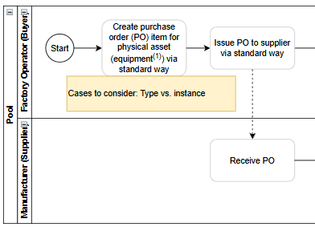
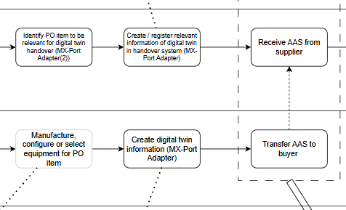
Requirement #37 – Async. Request / Reply for inform. about an asset
Starting workflows, that return asynchronous
Illustration
Initial situation
  The data requester places a request for information about an asset, that will be fulfilled by the data provider.
  The fulfillment will be completed after a processing time. The long processing time does not allow a request/reply pattern, instead the result will be provided asynchronously
Problem statement
  There shall be means to be able to
    formulate a request
    specify the asset and the desired information about the asset.
  The data provider shall provide a capability to
    receive a request or actively fetch an available request from a data requester
    process this request internally
    and then securely return the desired information about the asset to the data requester
  The data requester shall provide a capability to
    send a request or make a lists of requests available for the respective data provider
    receive the returned information
Boundary conditions
  The information about the asset can be completed in the business process of the data requester (order position, equipment number available at the beginning, ID link created/assigned later)
  Notes
  In UC3 the business process is a purchase order, the requested information is the handover documentation of an asset.
  In UC11 the business process is a R-grading request.

